Slide 1

DATE 12/10/2024
IWERC’S Marketing
Campaign
Kaixi Zhu

Slide 2
Shaping the Future:
Research in Education & Workforce

Slide 3
Increase the impact of IWERC and make its research findings more accessible to policy makers, academic institutions and businesses.
Strengthen industry cooperation and attract the attention of government agencies, educational organizations and enterprises.
Raise public awareness of the practical implications of research for students and job seekers, and promote the research results.
Goals

Slide 4



Online Promotion:
Reels/TikTok /BlueSky
+
Offline Promotion: University Cooperation Forum

Slide 5
Online Promotion: Short-form Videos (Reels/TikTok)
Area | Example Warm-up Video Content
Early Childhood Education | "Why is preschool education so important?"
K-12 Education | "Is your school an 'effective school'?"
Higher Education | "What do Illinois college students care about the most?"
Workforce | "Where are your future job opportunities?"

Slide 6
Online Promotion: Short-form Videos (Reels/TikTok)
Time Schedule
One week before | Research highlights + warm-up video
During the event | Sharing research results + interviewing researchers
One week after | Summarize the impact

Slide 7
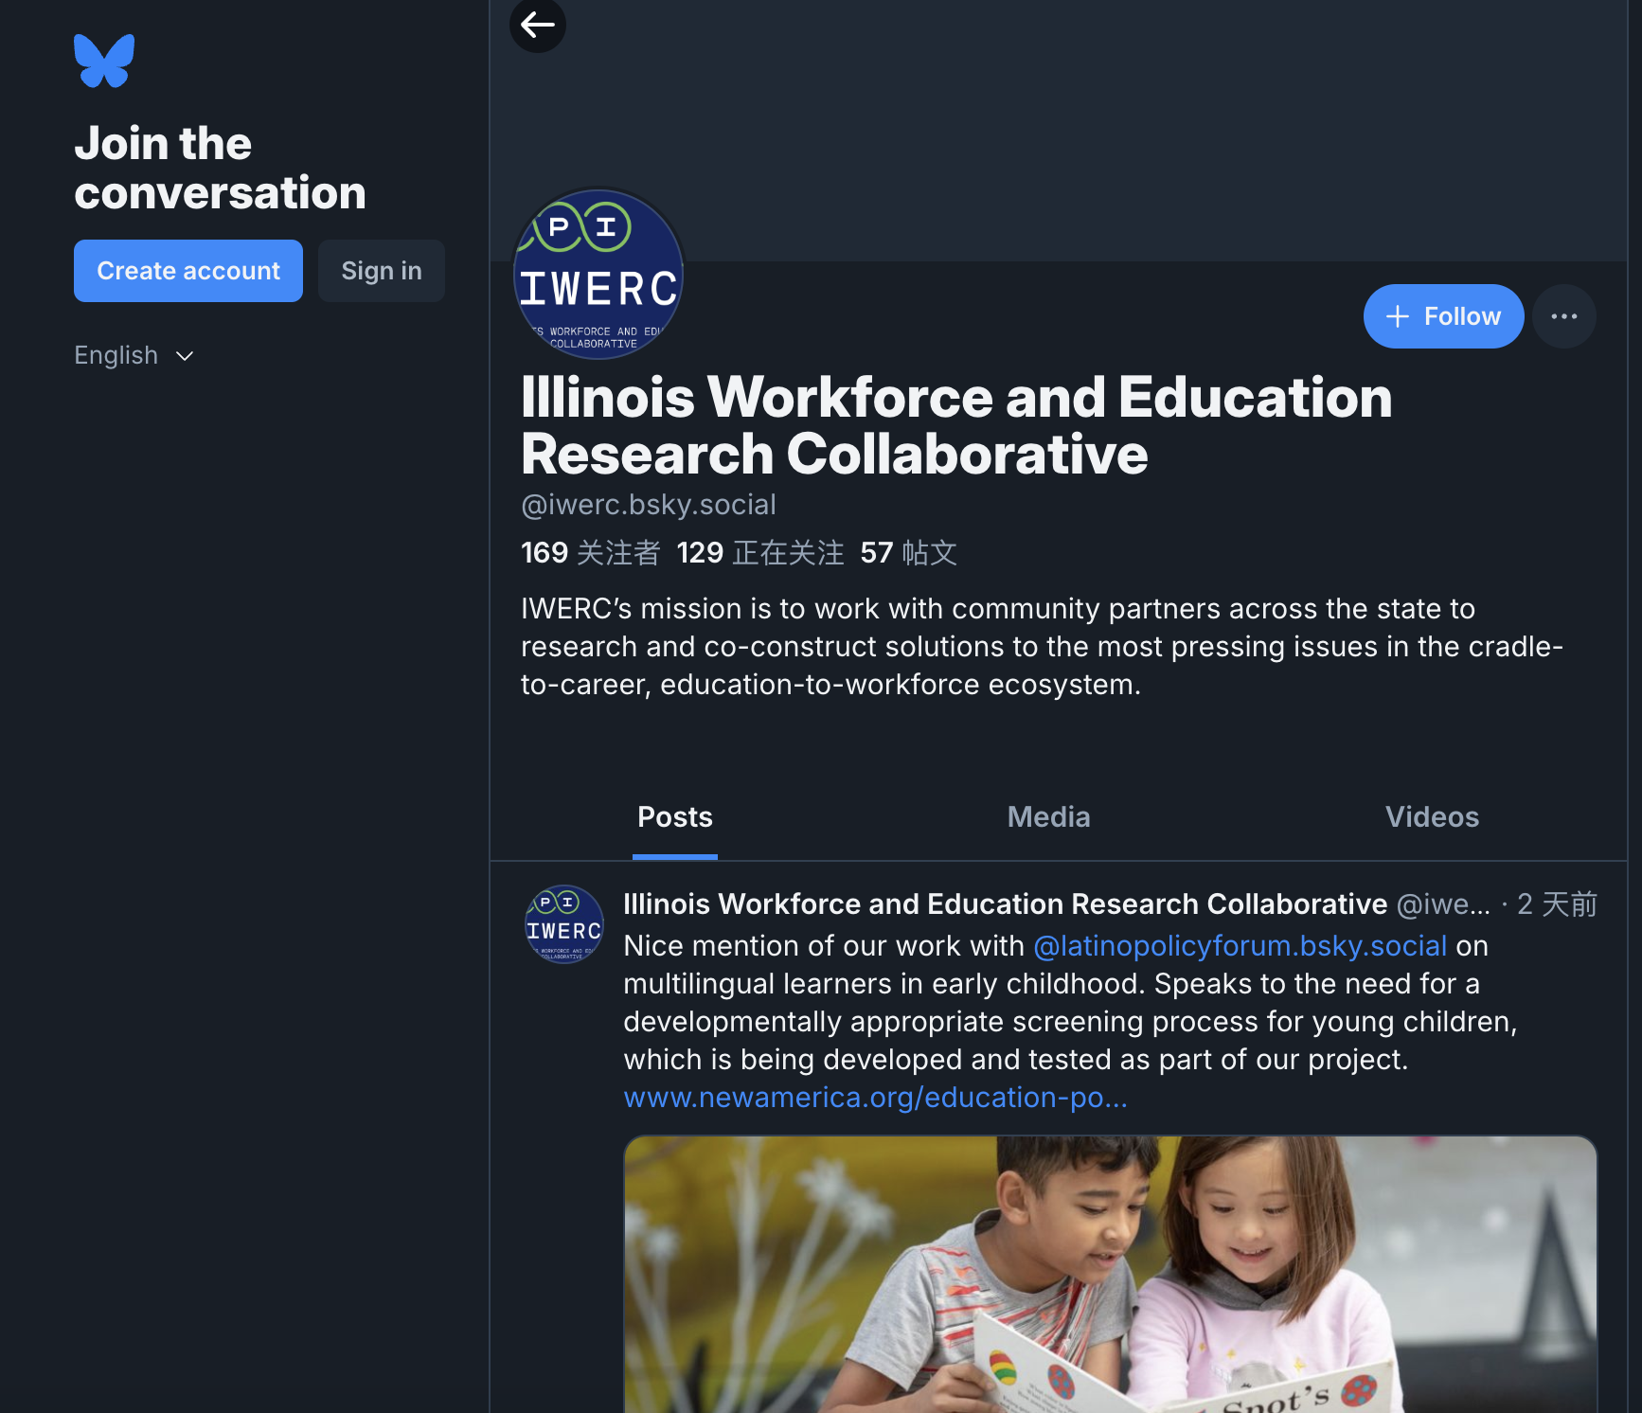
Online Promotion: Blue Sky
Purpose: To provide open discussion, enhance research credibility, and help connect policy makers, academics, and research institutions
Strategy: 1.Short text + short video combination to explain the research with concise academic viewpoints 2.Regular publication of IWERC research highlights to attract discussion 3.Use Hashtags such as #IWERC

Slide 8

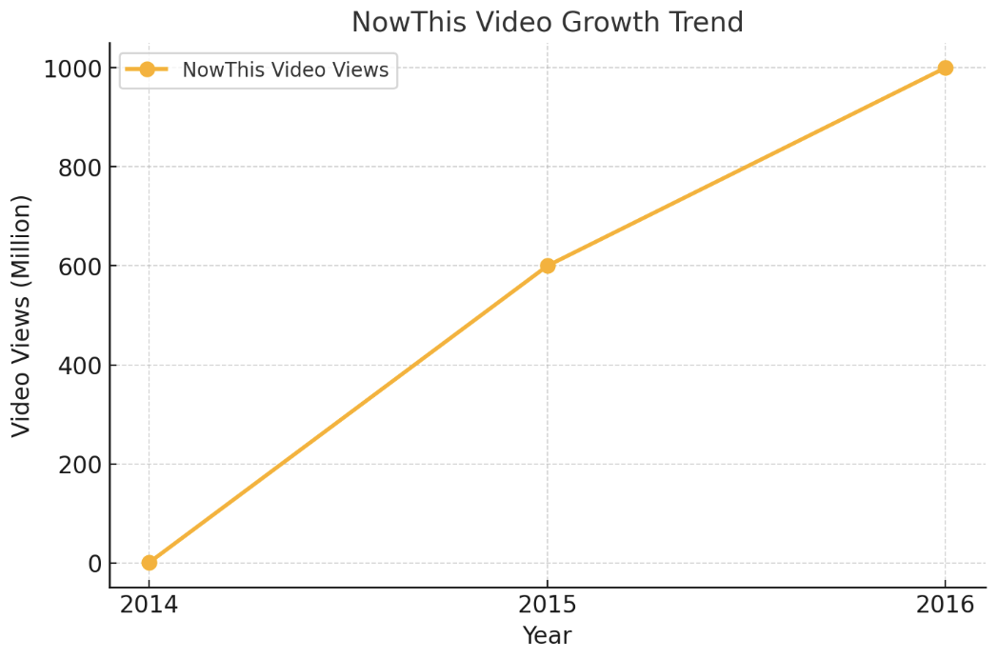
The Success of NowThis
NowThis is an American media company that targets mobile users of major social media platforms such as Facebook, Twitter and Snapchat, covering politics, economics, technology and entertainment.
They attracted viewers by producing short video news clips lasting 6 to 90 seconds, and the total number of views of the videos quickly grew to 1 billion.

Slide 9
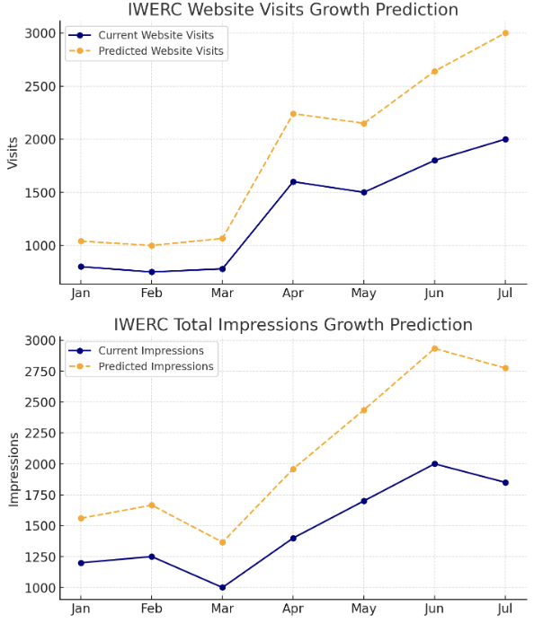
The Predicted Data after Online Promotion
NowThis's case shows that a research institution or academic platform can achieve a significant increase in user size and engagement rates by focusing on short video content production and actively leveraging social media platforms. ​

Slide 10
Offline Promotion: University Cooperation Forum
Objective: To invite policy makers, education experts, and business representatives to discuss practical applications of research findings.
Time: It will be held in target universities (such as UIUC, Northwestern University, University of Chicago, NIU) during the event after releasing the warm-up videos.

Slide 11
Offline Promotion: University Cooperation Forum
Forum Agenda
Theme: IWERC's research on university students and the labor market
Discussion: Corporate HR and university professors are invited to discuss the implementation plan of research results
Interaction: Students are encouraged to participate in discussions and ask questions on the spot.

Slide 12
Key Measurement Indicators (KPI)
Online:
1.Video views
2.Interaction rate
3.Usage of hashtag #IWERC
Offline:
1.Number of Forum participants
2.On-site student feedback
3.Follow-up contact and report

Slide 13
Next Move
✅ Contact target universities
✅ Plan short video content
✅ Invite guests & determine the event agenda
✅ Work out a detailed implementation timetable

Slide 14
Thank You

